Slide 1
INTRODUCTION
Topic:- Demonstration of Components of
i) Smart Phone
ii) i-Pad
Name:- Parth Agarwal

Slide 2
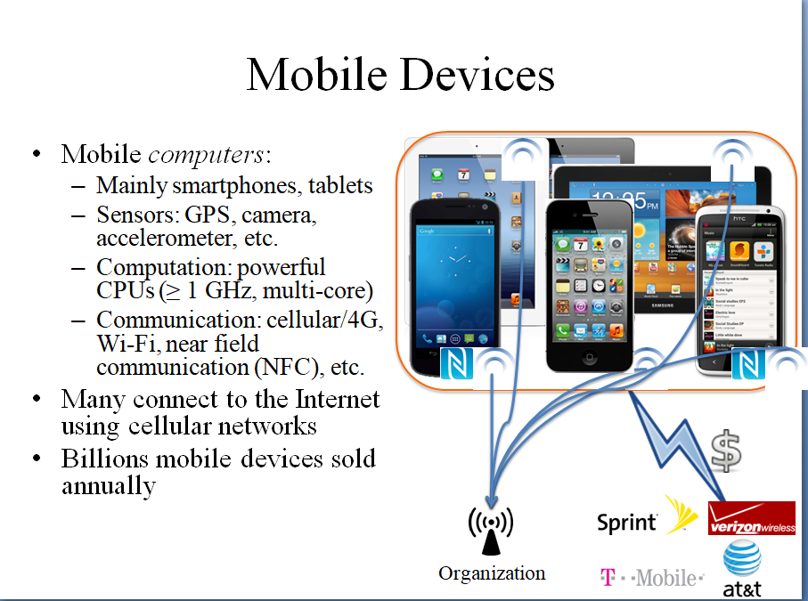

Slide 3
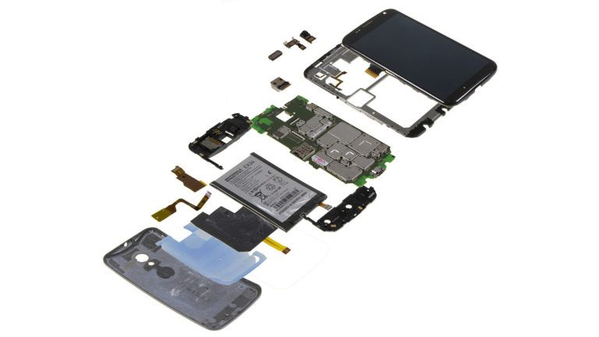
Short Bytes: There is a group of very complex components of a smartphone but that’s definitely not our first thought when we head out to purchase one, is it? However, it is still important to know the basic layers of hardware that help your device to function. Today we shall be breaking down the core parts present in what’s become as one of the essential devices of today’s computing age. Are you ready to find out more what’s inside a smartphone? Then let us begin.
i) Smart Phone:-

Slide 4

1. Display:-
Perhaps the most obvious components of a modern Smartphone is its display, and while every detail you see is on the outside, it is actually an internal component of the device. Display technologies in smart phones of today come in two main types:
Those based on LCDs (IPS technology and its variations)
Those based on LEDs (AMOLED or Super AMOLED and its variations)
LCD vs LED On an LCD-based display, there is a backlight that is shining through some polarizer's, and it is shining through some filters. And by manipulating the crystal display,
you can see a boatload of different colors on the other side.
What this means in simple terms is that the light is not being generated by the display itself;
it is being generated by the light behind the display, and only
some of it is coming from the other side
.

Slide 5
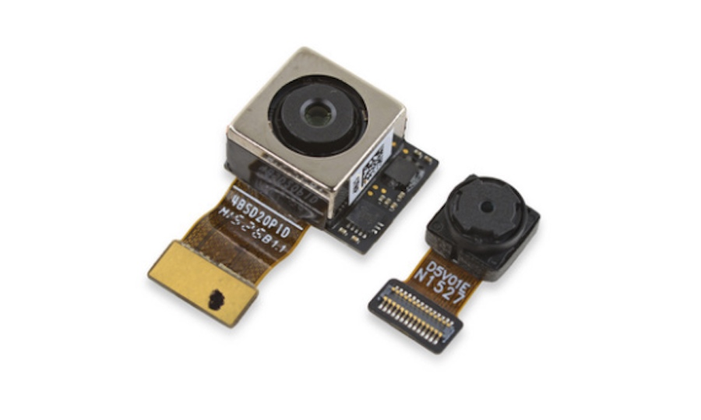
2. Camera:-
All smart phones come with a rear-facing and front-shooting camera. A smart phone comprises up of three main parts:
The sensor (which detects light)
The lens (the component in which light comes through)
The image processor
While the megapixels on the smart phone are still an important part of the camera, it carries less importance than it did a while back. Instead, the primary limiting factor is the camera sensor of the phone and how sensitive it is when light passes through the lens.

Slide 6
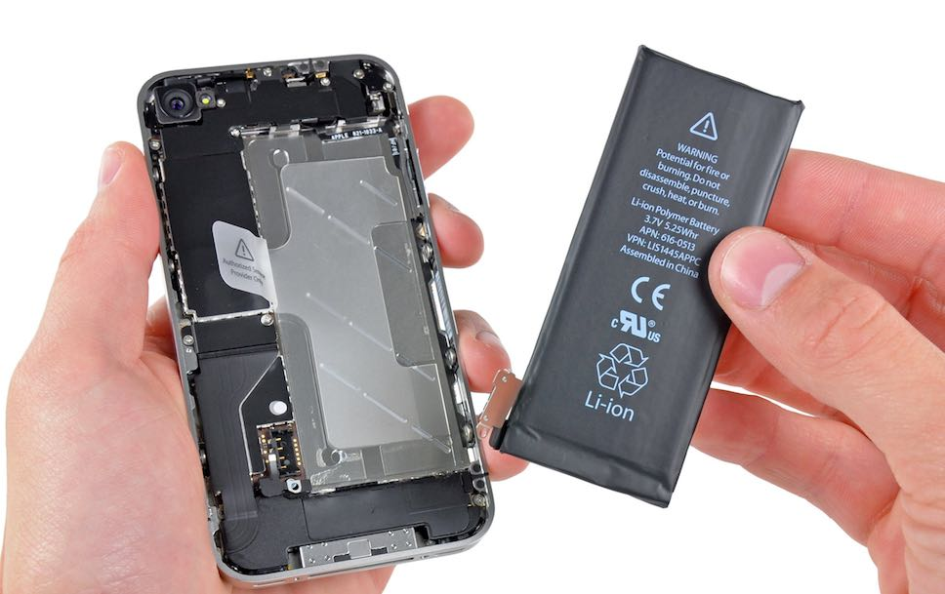
3. Battery:-
Batteries of phones normally use lithium-ion technology that are either removable or non-removable in mobile devices. With these batteries, which an important component of a smart phone, you will not have to worry about ‘calibration’ or ‘testing’ issues that were plagued with nickel-based cells. Still, this does not mean that current-generation batteries are not filled with their own issues, and users have to be very careful when handling and using volatile components like these.

Slide 7
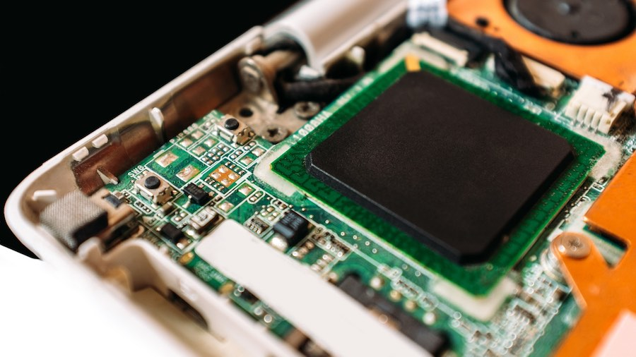
While you might see phones touting different SoCs from Qualcomm, MediaTek, Samsung, Huawei’s own Kirin and Apple’s own developed chipsets, they are using the same system architecture from ARM. ARM functions by not only producing their own processors and GPUs but by also licensing their design and system architecture to other companies, so they are able to use their technology to make powerful and efficient SoCs.
4. ‘System-on-a-chip’ or SoC:-
The SoC is perhaps the most important component present in a smartphone, and some users might confuse it as being the processor of the device. However, it is far more than that; the SoC not only comprises up of the smartphone’s CPU, but GPU, LTE modem, display processor, video processor.
Some companies also use architectural licenses so that they are able to make their proprietary processors for use in smartphones as long as they are compatible with ARM’s system architecture.

Slide 8
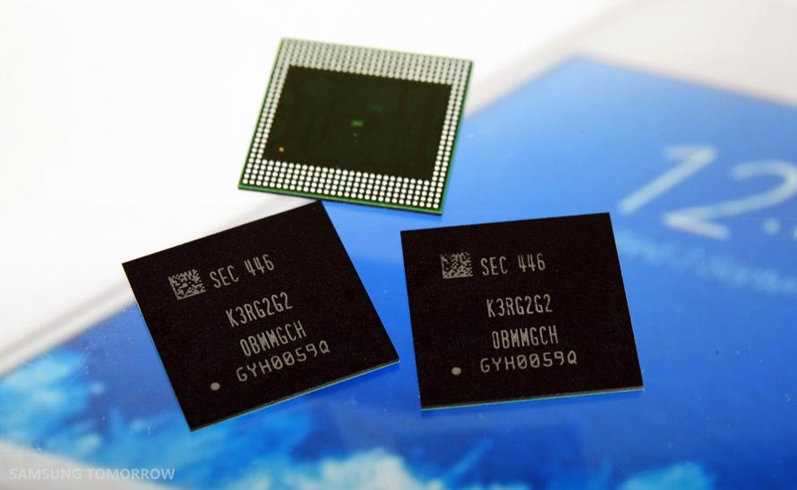
5. Memory and storage:-
No smartphone can function without the use of RAM and memory (system storage). First, let’s talk about the RAM; most mobile devices are shipped with LPDDR3 or LPDDR4, while some high-end smartphones are shipped with LPDDR4X RAM. ‘LP’ stands for ‘Low-Power,’ and it reduces the total voltage of these chips, making them highly efficient and giving mobile phones the extended battery life.

Slide 9
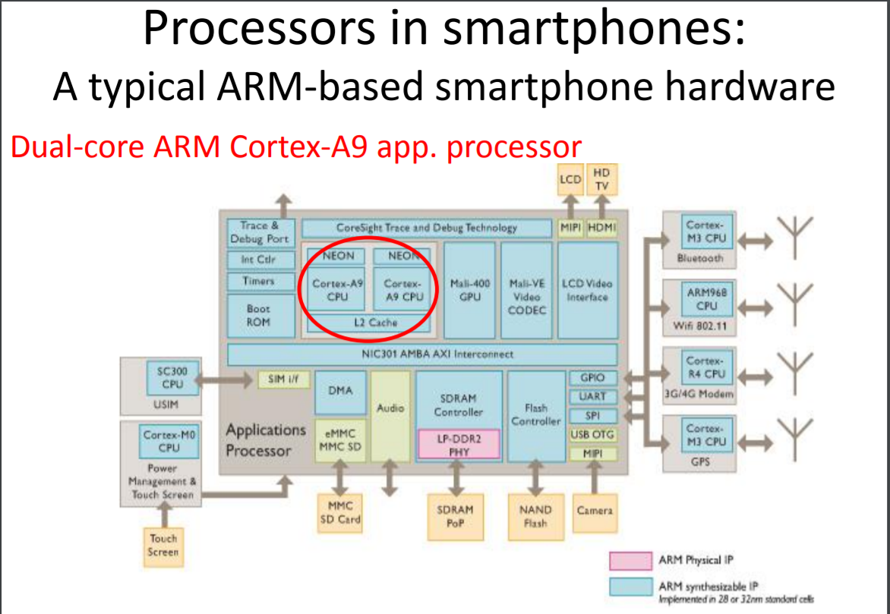

Slide 10
6. Sensors:-
There are five main sensors in a smartphone that allow it to give you that functionality of a ‘touch-enabled smart device’. The names of all these sensors and their importance have been detailed below:
Accelerometer: Used by apps to detect the orientation of the device and its movements, as well as allow features like shaking the phone to change music.
Gyroscope: Works with the Accelerometer to detect the rotation of your phone, for features like tilting phone to play racing games or to watch a movie.
Digital Compass: Helps the phone to find the North direction, for map/navigation purposes.
Ambient Light Sensor: This sensor is automatically able to set the screen brightness based on the surrounding light, and helps conserve battery life. This would also explain why your smartphone’s brightness is reduced in low-light environments, so it helps to reduce the strain on your eyes.
Proximity Sensor: During a call, if the device is brought near your ears, it automatically locks the screen to prevent unwanted touch commands.

Slide 11
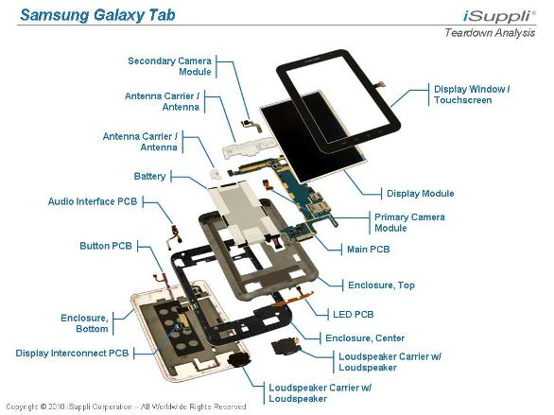
Apple Inc.’s latest iPad includes chips made by Broadcom Corp., Qualcomm Inc.
and Elide Memory Inc., the gadget-repair site iFixit reported after taking apart the tablet.
IFixit also said the new device, as expected, includes a high-resolution display made by Samsung
Electronics Co.
The newest version of the popular tablet device went on sale in some retail stores in Australia
to lines of eager customers hoping to be among the first to own the device. The new iPad sports
a speedier Apple-designed processor, a sharper screen and next-generation wireless Internet
connections, known as 4G LTE.
ii) i-Pad:-

Slide 12
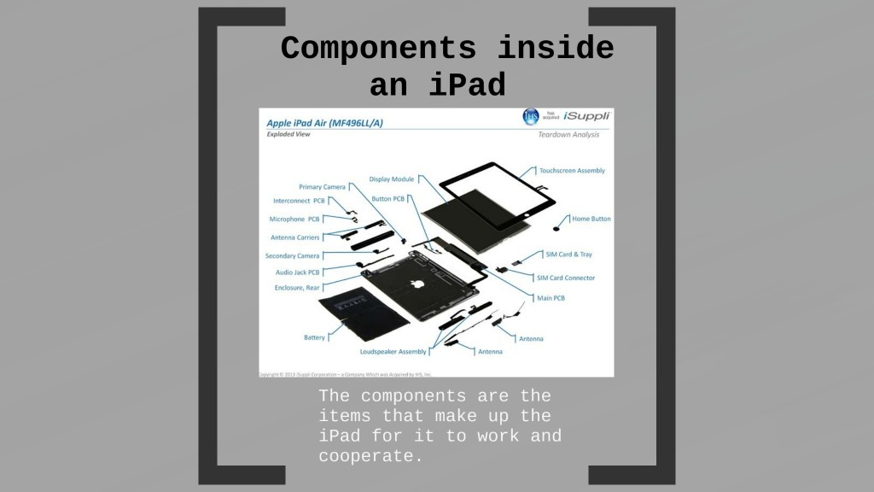

Slide 13
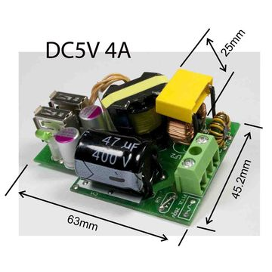
Broadcom, a communications-chip specialist in Irvine, Calif., made the chips used for Bluetooth and wireless Internet access, iFixit said after posting a so-called teardown report from Australia. Chips from San Diego-based Qualcomm are used by the iPad to connect to cellular networks, including 4G services using a technology called LTE.

Slide 14
Elpida, a Japanese company that has filed bankruptcy proceedings, supplied dynamic-random access memory chips for the iPad, the site added. IFixit also identified other memory chips from Toshiba Corp., also based in Japan.
Other chips identified by iFixit came from companies that include Texas Instruments Inc., Fairchild Semiconductor International and TriQuint Semiconductor Inc.

Slide 15
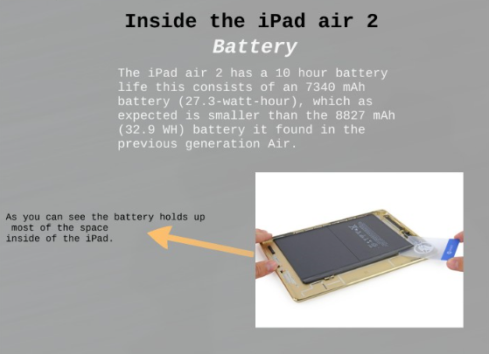
1.

Slide 16
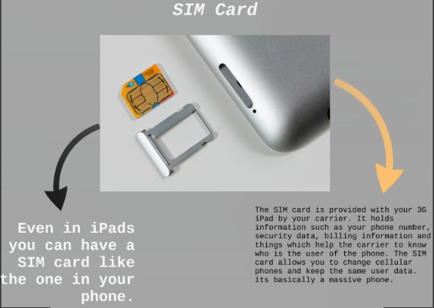
2.

Slide 17
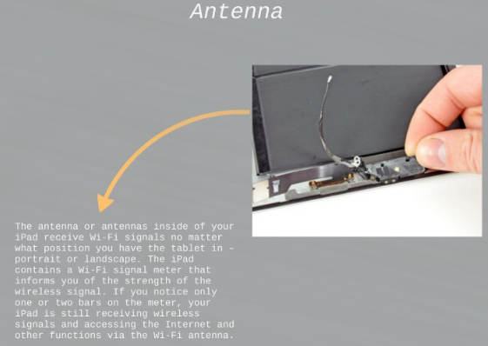
Apple has recently opened up more about the parts in its devices, however, publishing a list of its manufacturing partners and parts suppliers in its annual internal audit of its supply chain in January.
3.

Slide 18
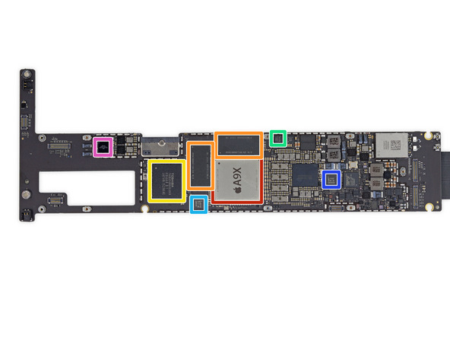
Landing a spot in Apple’s device is important for chip manufacturers,whose involvement often
helps to lift their appeal and brand awareness among investors. Apple, for its part, has been
secretive about the components it uses to create its devices, and often discourages users from
taking them apart.

Slide 19
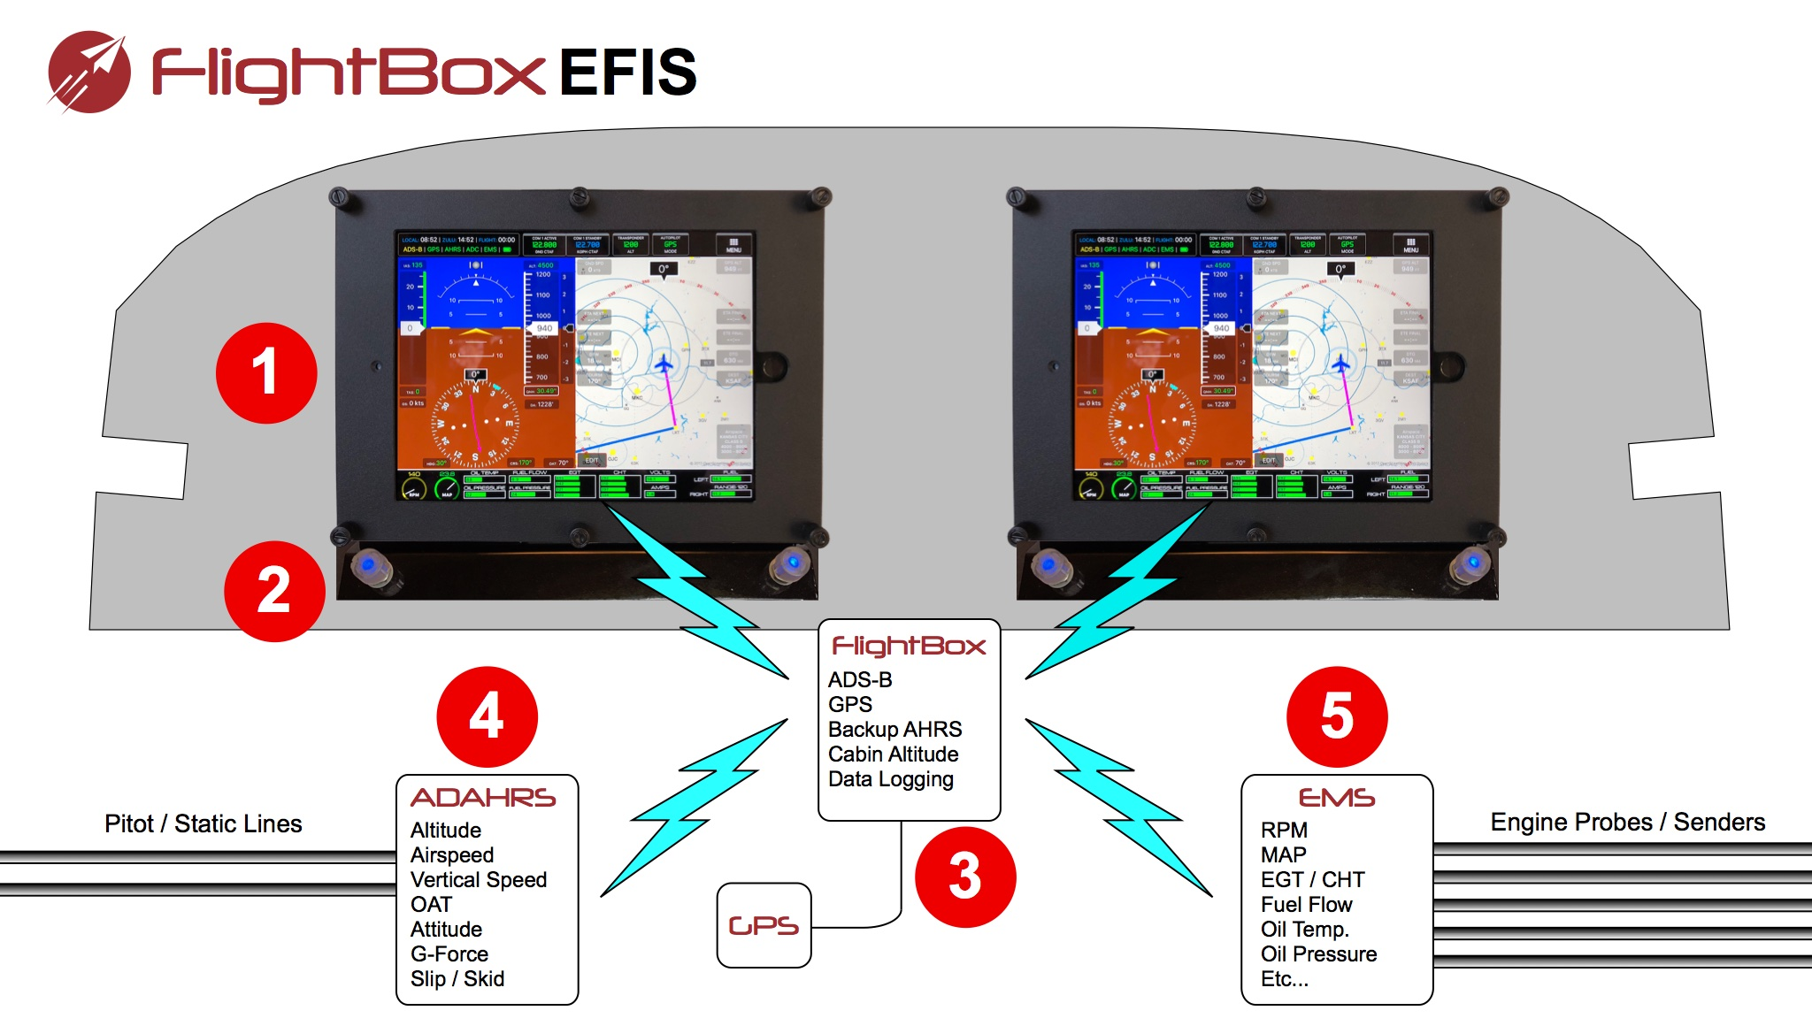
One of the highest-profile suppliers to the iPad is Samsung, whose display had earlier been reported to be the only one that met Apple’s specifications for the high-resolution screen and was being used in the device. Competing displays from Sharp Corp. and LG Display Co. recently met Apple’s requirements, according to people familiar with the matter, and Sharp’s components are expected to begin shipping soon.

Slide 20
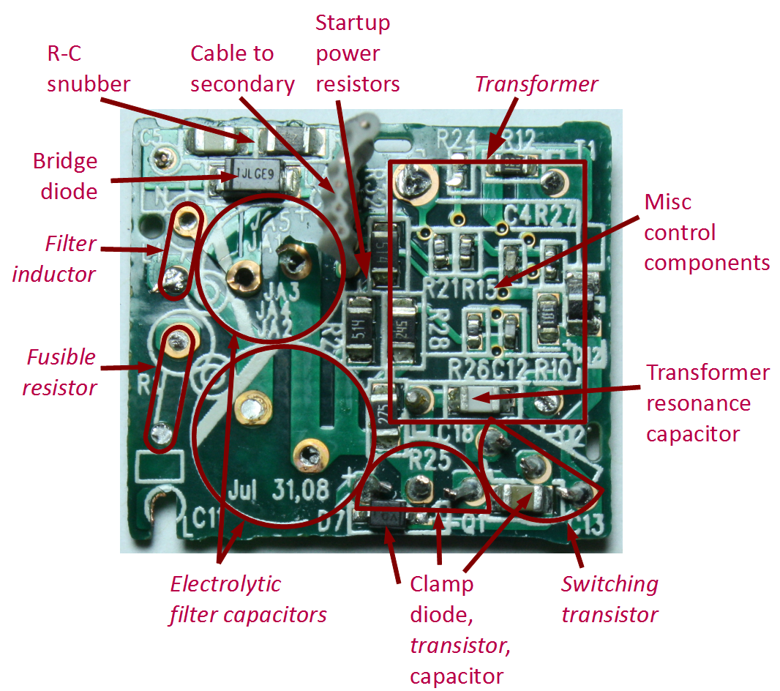
Samsung, which is currently locked in patent litigation with Apple, also the manufacturer of Apple’s third-generation processor, the A5X, according to iFixit. (The Korean company has built prior Apple-designed chips used in mobile devices). The firm said it found markings on the chip that said it was manufactured by Samsung in the first week of this year.

Slide 21


